Slide 1
Methods m Tim Cook Director of NAP program Consultant Anaesthesia/Intensive Care, Bath

Slide 2
5 phases
Baseline survey of anaesthetists perspectives/experiences
Baseline survey of allergy clinic organisation
Baseline organisational survey (NHS/IS*)
Year long registry (NHS/IS) Numerator
Allergen/activity registry Denominator
*IS=independent sector

Slide 3
5 phases
Baseline survey of anaesthetists perspectives/experiences
11,000 anaesthetists
Baseline survey of allergy clinic organisation
Baseline organisational survey (NHS/IS)
Year long registry (NHS/IS) Numerator
All NHS hospitals
Allergen/activity registry Denominator
96%

Slide 4
Set up
Local reporter
Consultant anaesthetist
Every participating hospital
Heartbeat of the project

Slide 5
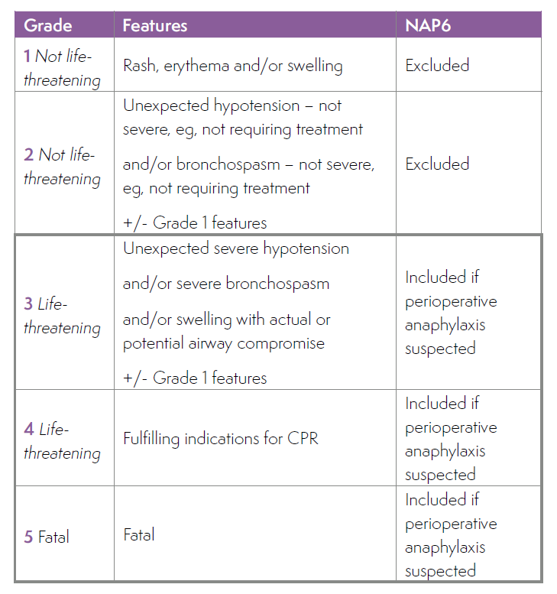
Inclusion
Peri-operative
any case involving an anaesthetist and a procedure

Slide 6
Inclusion

Slide 7
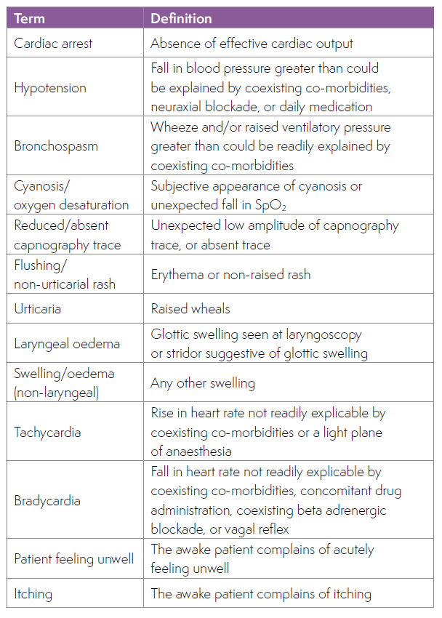

Slide 8
Reporting and the firewall
Request to report
Screening questions
Release of access code and password
Secure encrypted website
Tracking progress without content access
Final report to NH
Moderator

Slide 9
Panel
Multidisciplinary
Allergy/clinical immunology
Anaesthesia and subspecialties
Critical care
Lay members
Allergy charities
25 members
Monthly meetings
Organisational/planning
Case review
Data review
Report writing and review

Slide 10
Review
No knowledge of
Location
Individuals
Patient
Structured
Triplicate
Anaesthetists and other team members
Immunologists
All together

Slide 11
Big group - moderation
Allergists
Clinical immunologists
Anaesthetist
Layperson
Allergist/Immunologist
(12-25)
Anaesthetist
Lay member
Expert groups
Allergists
Clinical immunologists
Anaesthetist
Lay member
Expert groups
Anaesthetist
Lay member
Expert groups
Allergists
Clinical immunologists

Slide 12
Outcome bias: knowledge of poor outcome leading to ‘harsh judgement’
Caplan RA et al Effect of outcome on physician judgements of appropriateness of care. JAMA 1991; 265: 1957-60
Hindsight bias: exaggerated belief that a poor outcome would have been predicted
Henriksen K, Kaplan H. Hindsight bias: outcome knowledge and adaptive learning. Qual Saf Health Care 2003; 122(supp) 2): ii 46-50.
‘Group think’

Slide 13
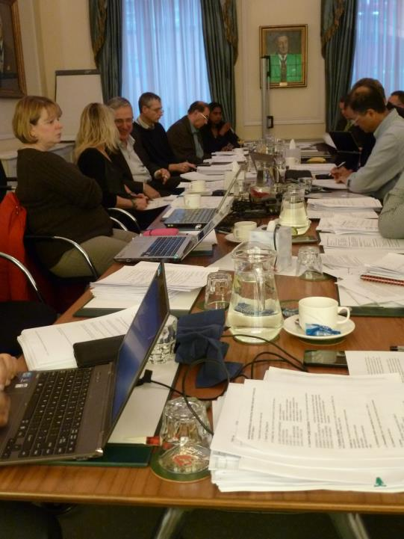

Slide 14
Structure - clinical
Part A
Immediate clinical management:
dx, treatment
speed, completeness
Further management
Referral
Patient outcomes
Part B
Clinic investigation
Quality of care
- Good
- Good and poor
- Poor
- Unassessable

Slide 15
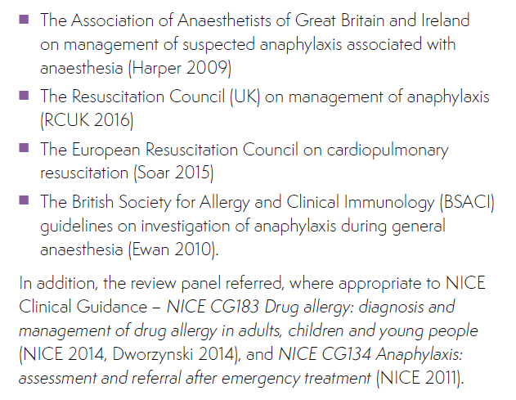
Benchmarking

Slide 16
Outcomes
Physical harm
Cardiac, cerebral, renal, respiratory
Psychological harm
Anxiety, PTSD, mood, movement, behavioural etc
Mild/mod/severe

Slide 17
Structure - immunology

Slide 18
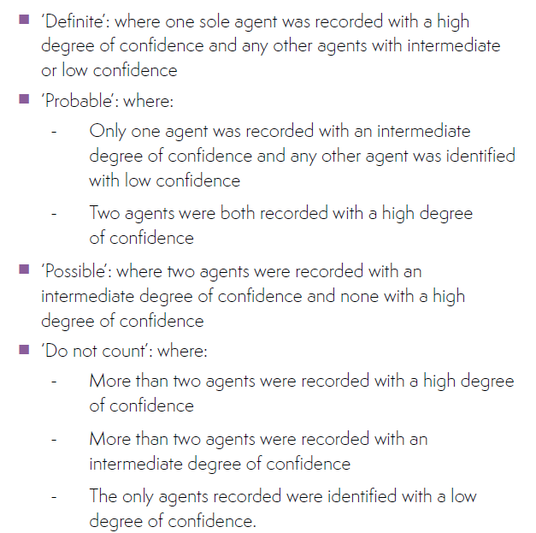
Structure – culprit identification
Step 1
Identify high/intermediate certainty of anaphylaxis
Step 2
Identify culprits and degree of certainty of each
Step 3
Classify culprits

Slide 19
Structure – culprit identification
Step 1
Identify high/intermediate certainty of anaphylaxis
Step 2
Identify culprits and degree of certainty of each
Step 3
Classify culprits
Definite/probable: included
Possible/do not list: excluded

Slide 20
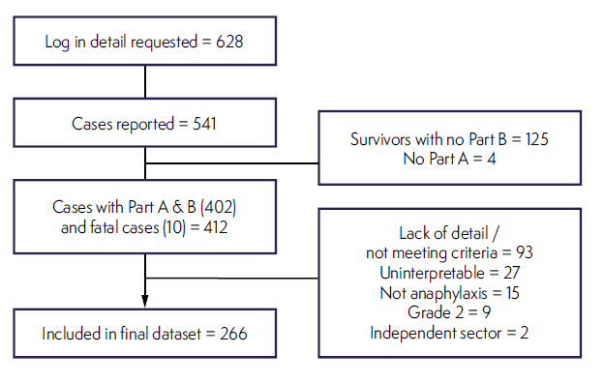
No website problems

Slide 21
Final spreadsheet
266 x 1555
= 430,000 data points

Slide 22
Final spreadsheet
Data collection closed
- May 2017
Report written
- Feb 2018

Slide 23
